Slide 1


Hii,
Iam Siddhika
Welcome to Power BI Series
Part -70
Varsha Chitikaneni

Slide 2



I’m very excited to dive into this with you all!
Are you ready to enhance your data visualization skills?
We focus only on the most used and important Visuals
Today Content
VISUALIZING DATA
DETAILED VIEW VISUALS
TABLE MATRIX

Slide 3
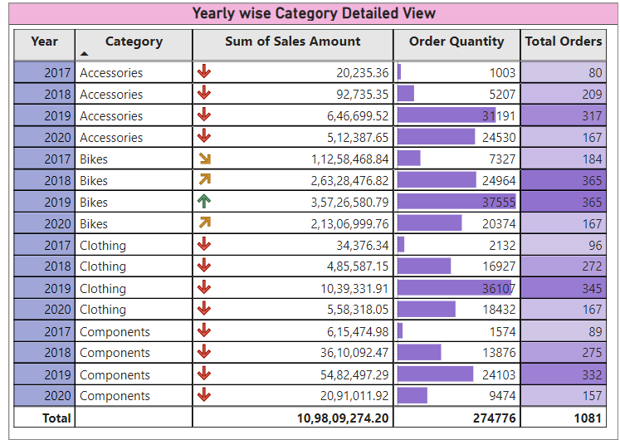


TABLE
A Table visual in Power BI displays data in a tabular format, similar to a spreadsheet.
It is used to present detailed data rows and columns, allowing users to view specific values and compare data easily.
It’s helpful for
drill through
feature to get
detailed view of a
data point.
we will check it in
furthur posts

Slide 4



Key Features:
Columns and Rows: Organizes data into columns and rows.
Sortable: Allows sorting data by clicking on column headers.
Filters and Slicers: Can be filtered using slicers or filters to view specific data subsets.
Aggregations: Supports aggregating data using measures.
When to Use:
Detailed Data View: To display a large amount of detailed data. Comparative Analysis: For comparing values across different categories or time periods.
Data Exploration: Ideal for exploring raw data without visual representation.
Formatting Tips:
Use conditional formatting to highlight important data points. Format columns for currency, percentages, dates, etc., for clarity. Add totals and subtotals where necessary for better analysis.
Go and explore Table visual Formatting

Slide 5
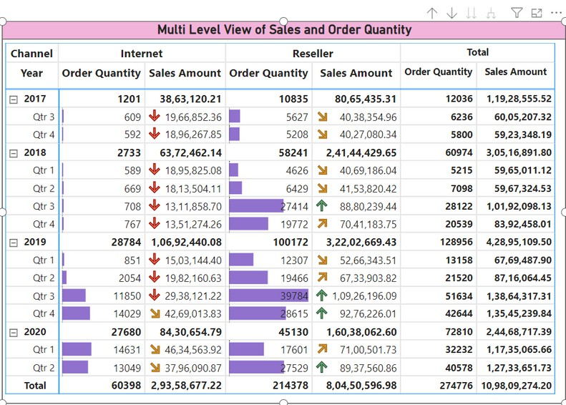

MATRIX
You can view in
multi dimensions.
check this
example matrix
visual and
understand...
A Matrix visual organizes data similar to a Table but also provides summarized totals by both rows and columns.
It's useful for analyzing data across multiple dimensions, providing a compact view of data summaries.

Slide 6
Key Features:
Rows and Columns: Organizes data into rows and columns, similar to a pivot table. Aggregations: Provides summarized values, such as sums, averages, or counts, at intersections of rows and columns.
Drill-down Capability: Allows users to drill down into details by expanding rows or columns.
Conditional Formatting: Supports conditional formatting to highlight key metrics.
Go and explore
more about matrix.There is lot to learn about matrix and its formating
When to Use:
Cross-dimensional Analysis: To analyze data across multiple categories or dimensions simultaneously.
Summarized View: For viewing data summaries without the need for detailed rows.
Comparative Analysis: Helps in comparing data across different categories or time periods in a structured format.
Formatting Tips:
Use row and column headers effectively to categorize data. Highlight important metrics using conditional formatting.
Utilize drill-downs to explore detailed data behind summaries

Slide 7


Thank you for joining me today to learn about Part -70 of Power BI!
Remember, Effective data visualization is crucial for turning data into meaningful insights and compelling narratives with Power BI.
Stay tuned for more insights and tips on Power BI in our next Series.
Follow

